Slide 1



Slide 2


Slide 3
UHD HDR Session Agenda
Introduction and forum progress | Thierry Fautier, Forum President
HDR 101 | Matthew Goldman (Ericsson)
Interoperability lessons learnt so far | Renard T. Jenkins (PBS)
HDR in live services – operator panel | Akira Shimazu (SkyPerfect TV), Renard T. Jenkins (PBS), Stephan Heimbecher (SKY).
Premium HDR: What are we doing to ensure a quality experience? | Mike Zink UHD Alliance (Warner Bros.)
The analyst’s view on UHD will be bringing in 2018 and beyond. | Colin Dixon (nScreen Media)
Q&A

Slide 4
Ultra HD Forum Progress
By NAB’17
Members
60
Guideline (Phase A)
V1.3 incl watermarking
Interop
Public Plug Fest (12+4) demos
Liaison
Engagement with DVB/ATSC/SMPTE/CTA
Communication
Master Class on HDR

Slide 5
What is coming Next ?
Interop
June’17 plug fest
DTG/German platform
Guideline (Phase B)
New HDRs, NGA, Backward compatibility, OTT Live,…
ATSC 3.0
Meeting in Korea (Fall’17)
Liaison
Work closer with UHD Alliance on Broadcast
Communication
Considering booth at IBC

Slide 6
UHD HDR Session Agenda
Introduction and forum progress | Thierry Fautier, Forum President
HDR 101 | Matthew Goldman (Ericsson)
Interoperability lessons learnt so far | Renard T. Jenkins (PBS)
HDR in live services – operator panel | Akira Shimazu (SkyPerfect TV), Renard T. Jenkins (PBS), Stephan Heimbecher (SKY).
Premium HDR: What are we doing to ensure a quality experience? | Mike Zink UHD Alliance (Warner Bros.)
The analyst’s view on UHD will be bringing in 2018 and beyond. | Colin Dixon (nScreen Media)
Q&A

Slide 7
High Dynamic Range Methods
Matthew Goldman
SVT Technology, TV & Media
Ericsson

Slide 8
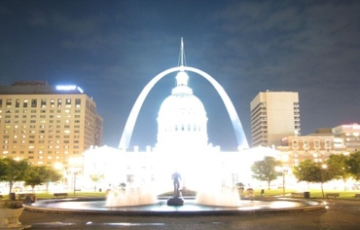


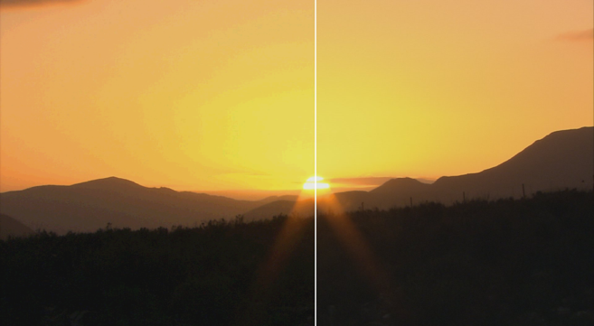
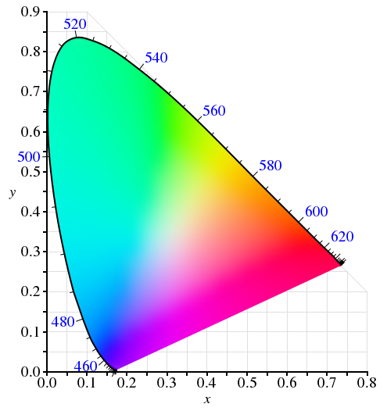


HDR System = HDR + WCG +
Higher Bit Depth
8b = Visible Banding
0110 1001 01
High Dynamic Range
10-bit
Sampling
An HDR system is a combination of HDR, WCG and higher sample precision technologies
Whether
3840 x 2160p
1920 x 1080p
or
Wide Color Gamut

Slide 9
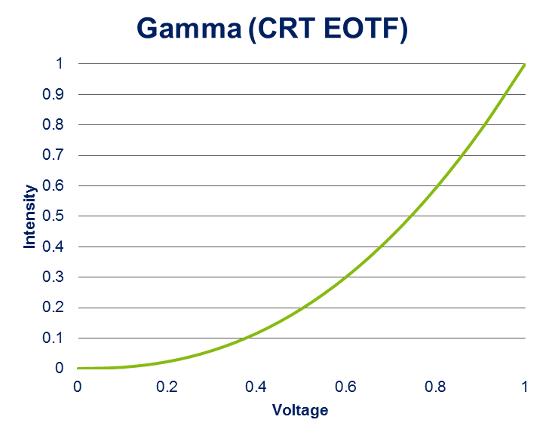
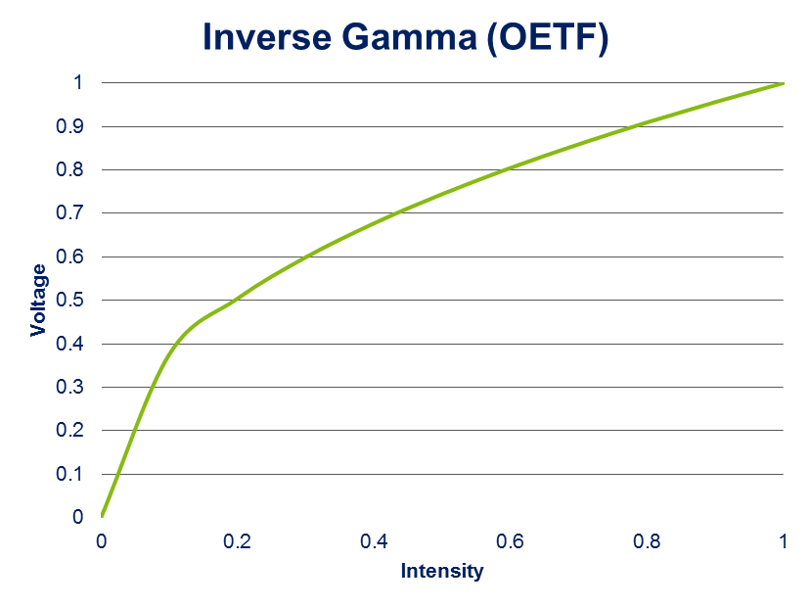


Television = tele + vision
From camera to display
Cameras convert scene light to an electrical signal, suitable of being transmitted over long distances, using an
opto-electronic transfer function (OETF)
Displays convert an electrical signal back to scene light using an electro-optical transfer function (EOTF)
For over 60 years, the cathode ray tube (CRT) was the universal display technology used
The response of a CRT to an input signal is not linear and its EOTF is commonly known as gamma
L = V^{γ}
where γ = 2.35
for HDTV
(ITU-R BT.709)
Scene
Capture
Transmission Medium
Scene
Display
OETF
EOTF

Slide 10
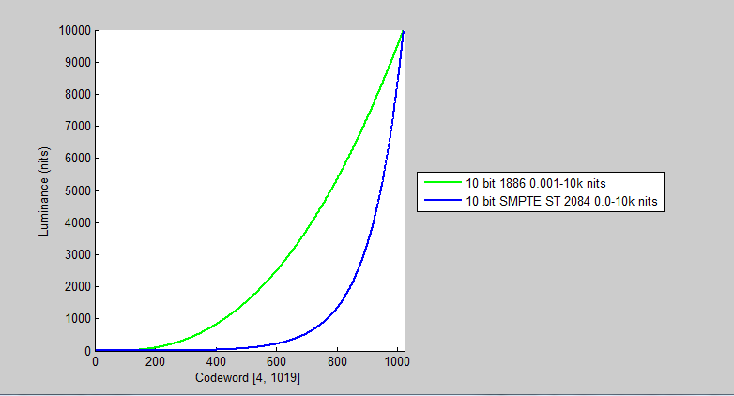
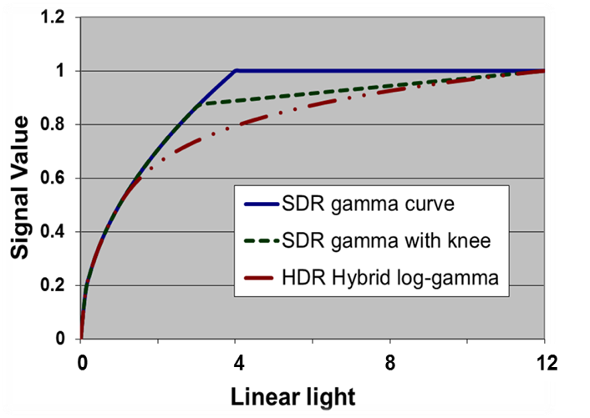
HDR Transfer Functions
Production reference for CRT peak white level is 100 nits
  Now referred to as standard dynamic range (SDR)
  SDR camera OETF comes from a desire to simplify analog TV electronics
      Inverse of CRT gamma (EOTF)
Rec. ITU-R BT.2100 defines 2 HDR transfer functions:
  SMPTE ST 2084 Perceptual Quantization (PQ) EOTF
  Hybrid Log Gamma (HLG) OETF
  Rec. ITU-R BT.2100 – Parameter values for high dynamic range television systems for production & international programme exchange
  Report ITU-R BT.2390 – High dynamic range television for production and international programme exchange (companion report to BT.2100)
10-bit levels over wider range

Slide 11
Ultra HD Forum Guidelines
Phase A: PQ10, HDR10, HLG10
PQ10 = SMPTE ST 2084 PQ HDR transfer function + Rec. ITU-R BT.2020 color space + 10-bit sample depth
HDR10 = PQ10 + reference display metadata
  Metadata = SMPTE ST 2086 HDR static metadata* + MaxCLL + MaxFALL
  Specified by Blu-ray® Disc Association, DECE, CTA, UHD Alliance for pre-produced content
  Uses HEVC Content Light Level SEI message
  *ST 2086:2014 – Mastering Display Color Volume Metadata Supporting High Luminance and Wide Color Gamut Images
    Specifies mastering display primaries, white point, and min/max luminance
HLG10 = HLG HDR transfer function + Rec. ITU-R BT.2020 color space +
10-bit sample depth
  No metadata

Slide 12

Static Container Mapping of HDR to SDR
Static Color Volume Mapping:
Container to Container
SDR Display Color Volume (ITU-R BT.709)
Image courtesy of Dolby
HDR Mastering Display Color Volume (SMPTE ST 2086)
Notes:
Knowing nothing about the content, a conservative color volume mapping approach is to map the entire HDR color volume to the target display color volume

Slide 13
Ultra HD Forum Guidelines for Consideration in Phase B
Dynamic metadata system(s)
PQ10 + frame-by-frame “Display Adaptation” metadata
SMPTE ST 2094-x suite – Content-Dependent Metadata for Color Volume Transformation of High Luminance and Wide Color Gamut Images
  Specifies dynamic metadata used in the color volume transformation of source content mastered with HDR and/or WCG imagery, when such content is rendered for presentation on a display having a smaller color volume
  The most important elements for live production are:
    Deep shadow => Min
    Mid-tone (facial and interior) => Mid
    Highlight regions => Max
      Computed on a frame-by-frame basis

Slide 14
Dynamic Content Mapping
From HDR to SDR
Map Brights Down
HDR Content Dependent Color Volume (SMPTE ST 2094-x)
Map Darks Up
Image courtesy of Dolby
Notes:
But if we know about the image characteristics, we can optimize this mapping.
In this example the source image contains colors that are both brighter and darker than SDR, so need to be mapped into range

Slide 15
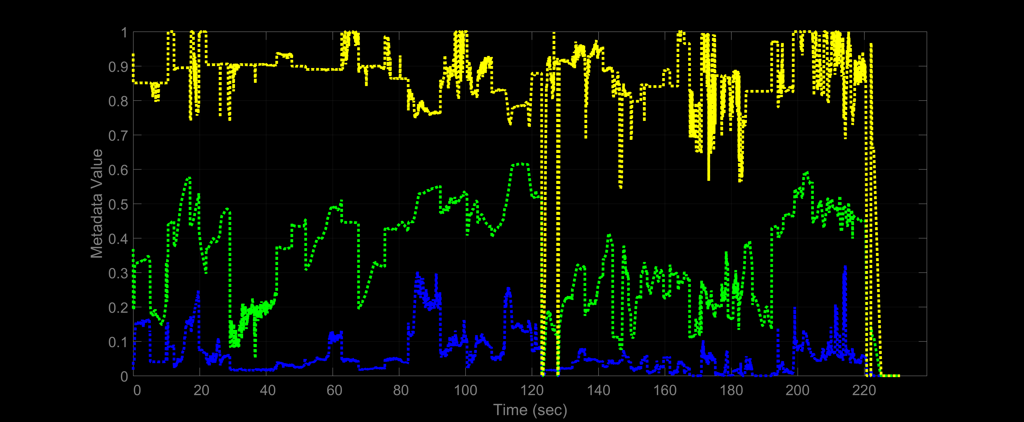
Per Frame: Min, Mean, Max
Per-Frame Metadata
Very dynamic
Image courtesy of Dolby

Slide 16
UHD HDR Session Agenda
Introduction and forum progress | Thierry Fautier, Forum President
HDR 101 | Matthew Goldman (Ericsson)
Interoperability lessons learnt so far | Renard T. Jenkins (PBS)
HDR in live services – operator panel | Akira Shimazu (SkyPerfect TV), Renard T. Jenkins (PBS), Stephan Heimbecher (SKY).
Premium HDR: What are we doing to ensure a quality experience? | Mike Zink UHD Alliance (Warner Bros.)
The analyst’s view on UHD will be bringing in 2018 and beyond. | Colin Dixon (nScreen Media)
Q&A

Slide 17

The AFC is a collaborative venture between the two public media organizations as well as PBS member stations, vendors and manufacturers. The mission of the AFC is to explore and develop procedures for the creation, processing and worldwide distribution of 4K/UltraHD, high dynamic range content with immersive audio through traditional, as well as new and exciting, digital distribution platforms.

Slide 18
Next-Gen Production/Transmission & consumer experience: UHDTV
(4K+HDR+WCG+NGA for broadcast TV)
Past AFC Milestones:
April 2013 – PBS displays via real-time playback UHD @ 29.97 8bit with Stereo Audio for the first time (ProRes 4444)
April 2014 – PBS successfully completes the first bi-coastal live UHD @ 29.97 10bit playback from WNET and KQED and displayed in Las Vegas. This feed contained first efforts at using PTP over IP. (HEVC @ 25mbps)
April 2015 – PBS successfully delivered the live playback of uncompressed UHD @ 59.94 10bit with 5.1 audio over IP (YUV)

Slide 19
Next-Gen Production/Transmission & consumer experience: UHDTV
(4K+HDR+WCG+NGA for broadcast TV)
Transmission:
The satellite transmission portion of the test was handled by SES on its UHD platform located on the SES-3 satellite. PBS originated UHDTV test feed carried next-gen content (per DVB-UHDTV phase 2 / ATSC 3.0 / UHDF Guidelines) containing 4Kp60 + WCG + HDR per BT.2100 (backward compatible HLG10) + DTS:X NGA (7.1.4 Immersive Audio).

Slide 20
Next-Gen Production/Transmission & consumer experience: UHDTV
(4K+HDR+WCG+NGA for broadcast TV)
Reception:
At reception end from satellite, signal was routed to a STB powered by a ViXS SoC from, which decoded & routed video to the HDR capable consumer displays with CTA HLG signaling. DTS:X immersive bitstream passed over HDMI to a 7.1.4 DTS:X AVR for final immersive rendering. Different A/V setups were tested, including backwards compatibility of HLG-HDR video with SDR displays, and immersive playback of DTS:X over different devices, including Yamaha (YSP-5600) sound bar.

Slide 21







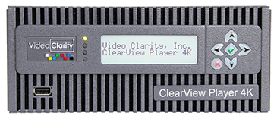



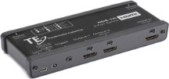



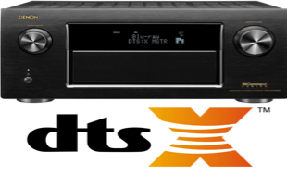




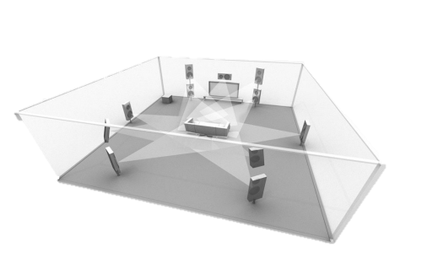

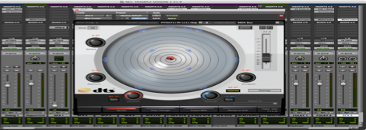



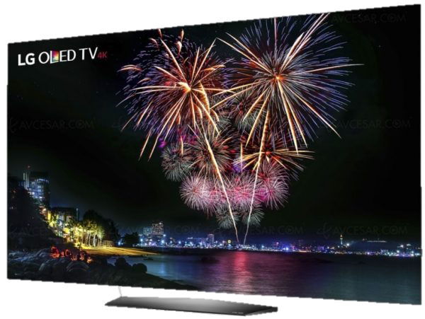


SAT
uplink
4 x
3G SDI
IP/Ethernet
Real-Time Linear encoder:
4K HEVC+DTS:X
UHDTV STB
MPEG defined
SEI/VUI messages
for BT.2100 HLG10
UHD Baseband
Simulated Live
Playout server
optional
ingest
Post
Produced
Mezz File
HDMI (CEA-861.3G)
.MDA
HDMI (CEA-861.3G)
Color
grading
Video
edits
camera
Grade for HLG10 per BT.2100
HLG HDR 4K

Slide 22
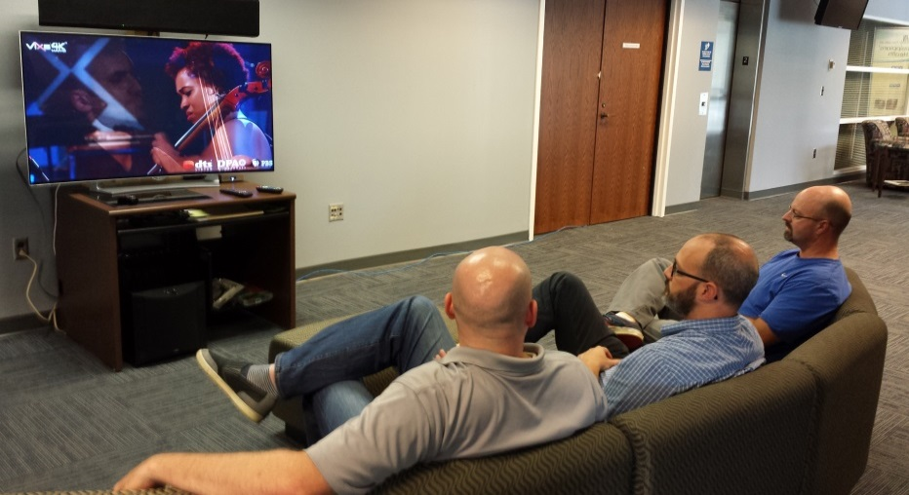
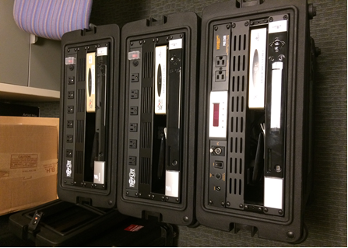
TPT and MPB Receives EM

Slide 23
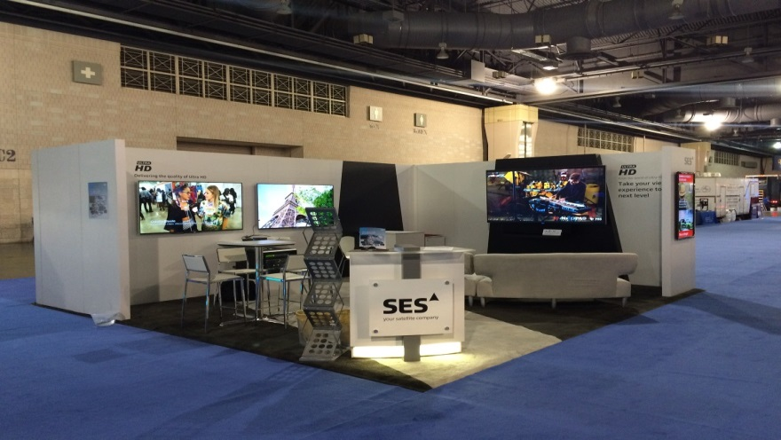
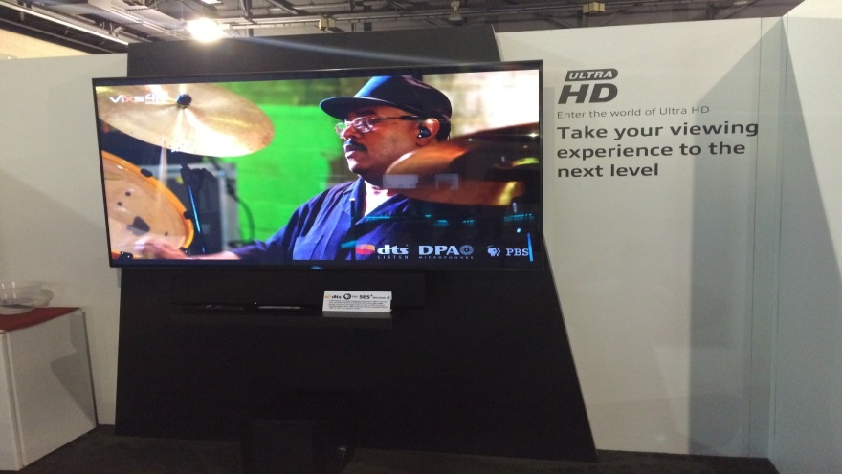
SES Streams EM into SCTE

Slide 24
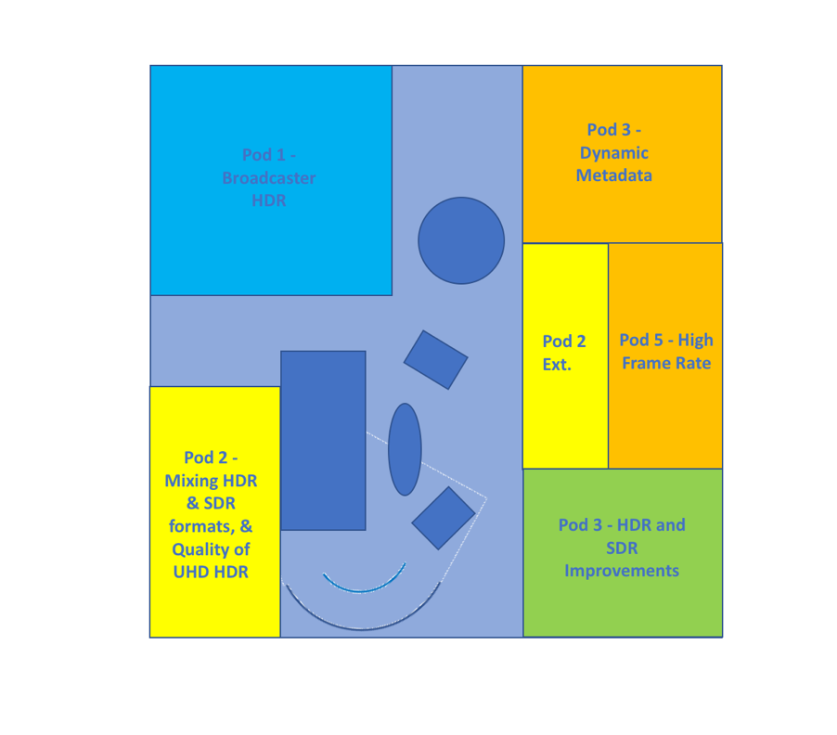
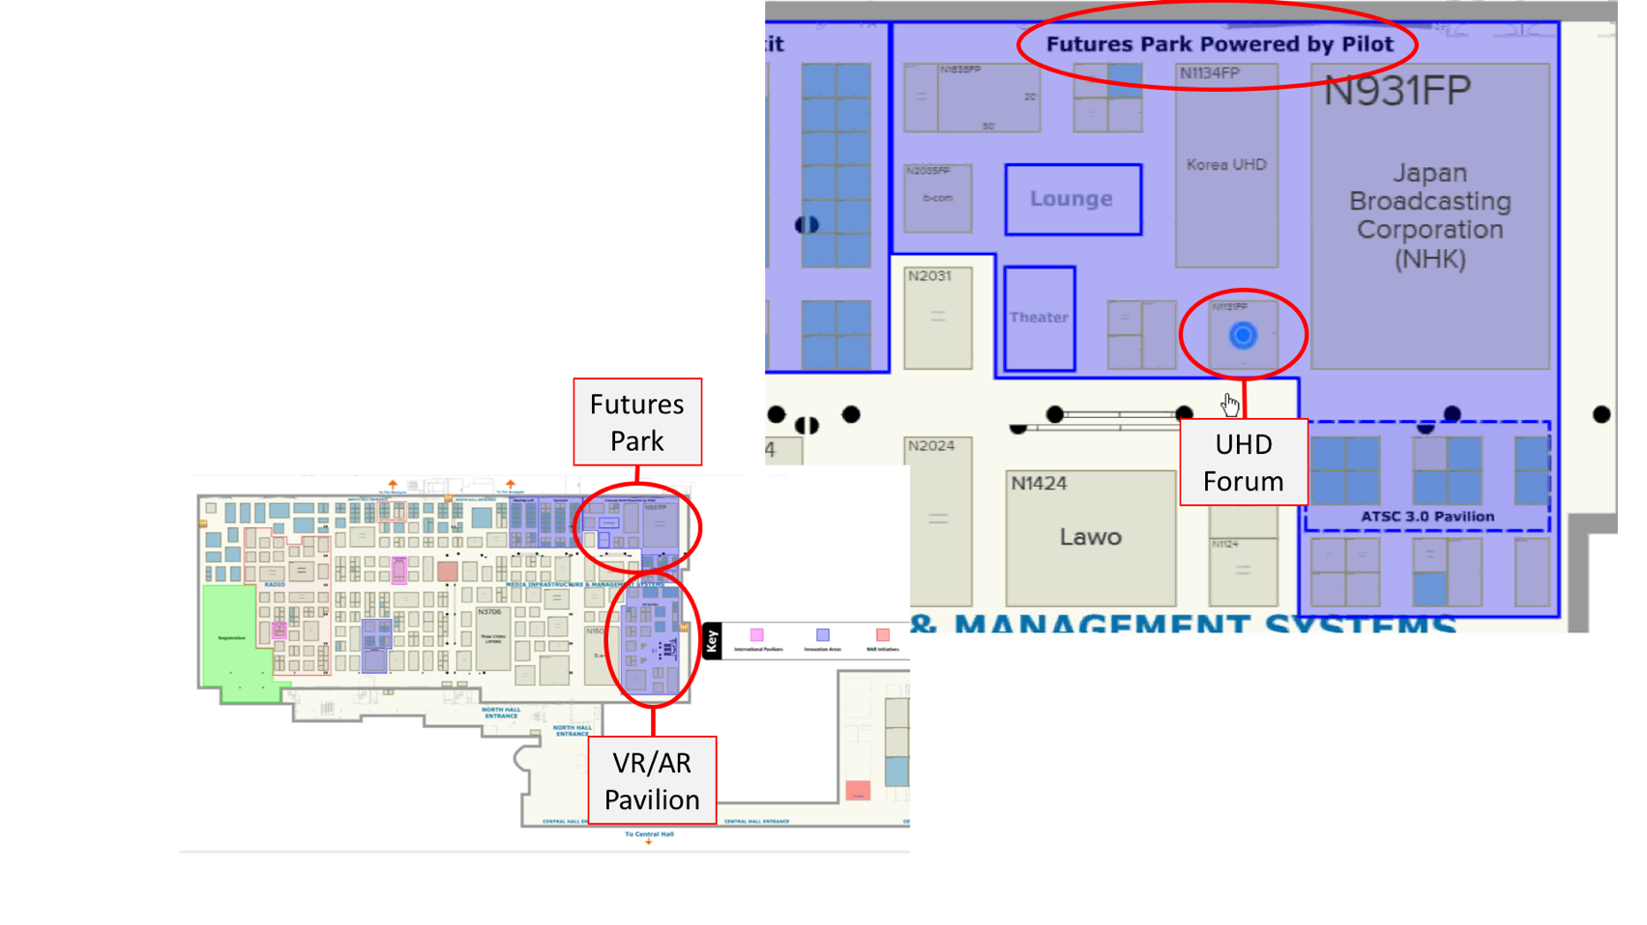
Ultra HD Forum Booth Layout – N1131FP
5 themed Pods

Slide 25






Companies contributing to demos

Slide 26
Booth Sponsors
Our booth gold sponsors this year are:
Our Silver sponsors are:
Espresso sponsor

Slide 27
Pod 1 Live HDR
DirecTV Live HLG HDR
HDR<>HDR Conversion
Satellite delivery of HLG encoded linear content with headend intermixing of SDR commercials
Delivery to Sony, LG and Sigma Design displays in SDR and HDR modes
DirecTV conversion of PQ content into HLG for display on HDR and SDR displays

Slide 28
Pod 2 Mixing HDR and SDR formats and the quality of UHD HDR
Receiver HDR/SDR Conversion
ABR HDR Video Delivery
Delivery of PQ content to Sigma based STB
STB converts HDR10/PQ to SDR or passes through SDR
Adaptive Bit Rate Streaming of HDR10 content to Sony display.

Slide 29
Pod 2 continued
Multi-Resolution HDR
SDR to HDR Conversion
A Neulion modified app that allows manual selection of varying resolution and bit rates for display on HDR display to demonstrate the impact of these variations on video quality
Headend and STB based SDR to HDR conversion

Slide 30
Pod 2 continued
Decoder Behaviors with mixed SDR and HDR Services
Optimised UHD for Reduced Bit Rates
Mix of SDR upconverted to HDR with or without tone mapping presented to Huawei STBs to demonstrate the decoder behaviour with mixed SDR/HDR
UHD 4K content processed by Beamr, delivered with quality at similar bit rates to HD content
Demonstrates how you can provide UHD content without (much) of the bandwidth pain

Slide 31
Pod 2 continued
Receiver Conversion from HLG to HDR 10
Demonstrates STB based dynamic conversion from HLG to PQ as needed depending on the delivered video stream and the display capability

Slide 32
Pod 3 - Dynamic Metadata – Future
HDR Formats and the Benefits of Dynamic Metadata
Demonstration of HLG, PQ and Dynamic Meta driven PQ side by side.

Slide 33
Pod 4 - HDR & SDR Improvements – Future
Advanced HDR
Provides full demonstration of Advanced HDR with quality conversion of HDR to SDR, display on an SDR screen and reconstitution on an HDR

Slide 34
Pod 4 - continued
Simulcast SDR and HDR
Impact of Variation of Peak Luminance
Demonstration of down-conversion of a HDR based service to SDR for simulcast purposes as part of the Advanced HDR solution
Shows how varying the peak luminance of the display impacts the displayed image using single graded content.

Slide 35
Pod 5 - High Frame Rate Video - Future
A demonstration of High Frame Rate (120fps) content playback using HDR and HD resolution

Slide 36
UHD HDR Session Agenda
Introduction and forum progress | Thierry Fautier, Forum President
HDR 101 | Matthew Goldman (Ericsson)
Interoperability lessons learnt so far | Renard T. Jenkins (PBS)
HDR in live services – operator panel | Akira Shimazu (SkyPerfect TV), Renard T. Jenkins (PBS), Stephan Heimbecher (SKY).
Premium HDR: What are we doing to ensure a quality experience? | Mike Zink UHD Alliance (Warner Bros.)
The analyst’s view on UHD will be bringing in 2018 and beyond. | Colin Dixon (nScreen Media)
Q&A

Slide 37

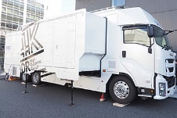
- HLG broadcasting will expand in Japan-
UHD HDR broadcasting [Japan]
2015
2016
2017
2018
Mar.
Oct.
Mar.
SKY PerfecTV
4K
HDR
HDR/SDR
Mixed prog.
Own channels
All programs
-4K
-HEVC 35Mbps
-BT.2020
-10 bit
-59.94fps
4K: broadcasted 500 programs
4KLive: 112 sports live, 6 music live
4KHDR: broadcasted 20 programs
4KHDRLive: 1 Football live
All HLG
4KHDR OB Van
Slog3 workflow
Feb.2017~
Produced in Slog3, converted to HLG/BT2020 & HD709
4K/8K HDR broadcasting in Japan
4K/8K
HDR
(HLG)
4K broadcasting
-J:COM(cable) 4K channel
-NTT(IPTV) 4K/HDR channel
(baseball live with HLG)
Coming 4K/8K HDR broadcasting
-All key stations will start UHD/HDR
satellite broadcasting (Total 19 channels)
-HDR will be HLG
SKY-P
platform

Slide 38




















Feb-May
HDR tests
8/9 Dec
3rd UHD
Plugfest
1 Dec
50/100p
23 Apr
signal flow
17 May
full 50p live
end-to-end
test
16-21 Apr
NAB
25/26 Jun
subjective HDR viewing tests
4 Nov
new UHD
production
style test
30 May
UHD production CL Final
Oct 2016
Sky D
UHD launch
6-17 Sep
24p HEVC
via satellite
2 Feb
contribution
test
6-9 Jan
CES 2016 / launch UHD Alliance spec
Ultra HD & HDR
test roadmap
25 Jan
30/120p
Sept
IFA/IBC 2015
BT.2100
… 2012
2013
2014
2015
2016
end 2011
project start
26 Jan
30/120p
24 Jul
24p and
multi-view
22 Oct
superzoom
live
13 Aug
HD/UHD
comparison
test
01 Aug
HDR Live Test
Supercup
spring
launch
UHD Blu-ray
29-31 Jul
HDR Live Trial
Beach Volleyball
26 Apr
full 50p live
end-to-end
test
20 Dec
live UHD
concert
production
06 Jun
UHD production German Cup Final
27 Feb
30/120p
NAB 2016
Ultra HD Forum
Phase A guidelines
28-30 Oct
HDR Production
“Yello” concerts
Preparation
Production tests
Live tests
HDR tests (in progress)

Slide 39
Panel
Chair: Ben Schwarz
Akira Shimazu (SkyPerfect TV),
Renard T. Jenkins (PBS),
Stephan Heimbecher (SKY).

Slide 40
UHD HDR Session Agenda
Introduction and forum progress | Thierry Fautier, Forum President
HDR 101 | Matthew Goldman (Ericsson)
Interoperability lessons learnt so far | Renard T. Jenkins (PBS)
HDR in live services – operator panel | Akira Shimazu (SkyPerfect TV), Renard T. Jenkins (PBS), Stephan Heimbecher (SKY).
Premium HDR: What are we doing to ensure a quality experience? | Mike Zink UHD Alliance (Warner Bros.)
The analyst’s view on UHD will be bringing in 2018 and beyond. | Colin Dixon (nScreen Media)
Q&A

Slide 41

The UHD Alliance
Create Industry Alignment with cross-industry participation of the entire ecosystem, incl. consumer electronics, content creators, content distributors, and enabling technologies.
Define Full-Featured Ultra HD as a robust set of features that combines enhancements in resolution, brightness, contrast, color and audio to bring a true-to-life experience to the home.
Ensure a Premium Consumer Experience by providing consumers with a single mark identifying premium products, content and services.
Notes:
Wants – when this slide shows up for first time: The UHD Alliance line shows, and then just the words in their relative positions as now: Create Define Ensure. Then with each click, rest of Create will come , click 2 rest of define will come in, click 3 rest of Ensure will come in

Slide 42


Technical Specification Development Process
Determine the technical parameters that impact the consumer experience.
Perform consumer research (qualitative &
quantitative) to gather consumer feedback.
Determine performance metrics based on consumer research findings.
Finalize Technical Specifications for content, distribution, and devices.
Content
Distribution
Devices
Notes:
Wants – when this slide shows up for first time: The UHD Alliance line shows, and then just the words in their relative positions as now: Create Define Ensure. Then with each click, rest of Create will come , click 2 rest of define will come in, click 3 rest of Ensure will come in

Slide 43
Content Specifications
Content Master Requirements (mandatory)
Image Resolution | 3840 x 2160
Color Bit Depth | Min. 10 bit signal
Color Palette | BT.2020 color representation
High Dynamic Range | SMPTE ST2084 EOTF
Mastering Display Recommendations
Display Reproduction | Min. 100% of P3 colors
Peak Brightness | More than 1000 nits
Black Level | Less than 0.03 nits
Notes:
Wants – when this slide shows up for first time: The UHD Alliance line shows, and then just the words in their relative positions as now: Create Define Ensure. Then with each click, rest of Create will come , click 2 rest of define will come in, click 3 rest of Ensure will come in

Slide 44
Distribution Specifications
Distribution Requirements (mandatory)
Image Resolution | 3840 x 2160
Color Bit Depth | Min. 10 bit signal
Color Palette | BT.2020 color representation
High Dynamic Range | SMPTE ST2084 EOTF
Notes:
Wants – when this slide shows up for first time: The UHD Alliance line shows, and then just the words in their relative positions as now: Create Define Ensure. Then with each click, rest of Create will come , click 2 rest of define will come in, click 3 rest of Ensure will come in

Slide 45
Device Specifications
Device Requirements (mandatory)
Image Resolution | 3840 x 2160
Color Bit Depth | Min. 10 bit signal
Color Palette | Signal Input: BT.2020 color representation
 | Display Reproduction: More than 90% of P3 colors
High Dynamic Range | SMPTE ST2084 EOTF
 | A combination of peak brightness and black level, either:
 | Peak brightness > 1000 nits & black level < 0.05 nits OR
 | Peak brightness > 540 nits & black level < 0.0005 nits
Notes:
Wants – when this slide shows up for first time: The UHD Alliance line shows, and then just the words in their relative positions as now: Create Define Ensure. Then with each click, rest of Create will come , click 2 rest of define will come in, click 3 rest of Ensure will come in

Slide 46

The ULTRA HD PREMIUM logo allows consumers seeking a premium, full featured Ultra HD experience to purchase with confidence.

Slide 47
Battery Operated Device Specifications
(announced at MWC 2017)
Device | Resolution | Dynamic Range | Color Space | Bit Depth
Phone 3”- 7” | 60 pixels/degree | .0005-540 nits | 90% of P3 Color gamut | 10
Tablet 7”- 12.9” | 60 pixels/degree | .0005-540 nits | 90% of P3 Color gamut | 10
Laptop 9.5”- 18” | 60 pixels/degree | .0005-540 nits or 0.1-600 nits | 90% of P3 Color gamut | 10
Notes:
Wants – when this slide shows up for first time: The UHD Alliance line shows, and then just the words in their relative positions as now: Create Define Ensure. Then with each click, rest of Create will come , click 2 rest of define will come in, click 3 rest of Ensure will come in

Slide 48

The MOBILE HDR PREMIUM logo confirms that a device meets the UHDA-defined performance criteria and delivers a consistent premium experience.

Slide 49
Certification & Logo Licensing Program
Test Specifications clearly define the testing methodologies to ensure compliance with all aspects of the Technical Specifications.
Multiple Authorized Test Centers have been established to independently test and certify products for compliance with respective specifications.
Licensing: Companies interested in developing ULTRA HD PREMIUM products may obtain the specification and license the logo by contacting: http://www.uhdalliance.org/contact-us/
Notes:
Wants – when this slide shows up for first time: The UHD Alliance line shows, and then just the words in their relative positions as now: Create Define Ensure. Then with each click, rest of Create will come , click 2 rest of define will come in, click 3 rest of Ensure will come in

Slide 50
UHD HDR Session Agenda
Introduction and forum progress | Thierry Fautier, Forum President
HDR 101 | Matthew Goldman (Ericsson)
Interoperability lessons learnt so far | Renard T. Jenkins (PBS)
HDR in live services – operator panel | Akira Shimazu (SkyPerfect TV), Renard T. Jenkins (PBS), Stephan Heimbecher (SKY).
Premium HDR: What are we doing to ensure a quality experience? | Mike Zink UHD Alliance (Warner Bros.)
The analyst’s view on UHD will be bringing in 2018 and beyond. | Colin Dixon (nScreen Media)
Q&A

Slide 51

Toward UHD 2020
Colin Dixon, Founder & Chief Analyst, nScreenMedia
colin@nscreenmedia.com | twitter: @nscreenmedia

Slide 52
Don’t expect much from UHD discs
Early results for UHD Blu-ray look good
Millionth UHD Blu-ray sold Oct 2016
But the long term trajectory for disc sales is down
Disc sales $7.8B in the US in 2013
$5.5B in 2016
Consumers are swapping disc ownership for SVOD library access
SVOD US revenue in 2013: $3.2B
$6.2B in 2016

Slide 53
The immediate future of UHD is streaming
There is some movement with linear TV
Japan says it will be all-UHD by 2025
  “In Japan, public and private sectors are working together to promote 4K and 8K. We have formulated the Road Map as a common goal for the stakeholders such as broadcasters and equipment manufacturers and government.” Masayuki Suga, Deputy Director, Ministry of Internal Affairs and Communications, Japan
  Japan Olympics in 2020 is a major driver for this
DirecTV will live broadcast The Masters in UHD on two dedicated channels
No other regions talking about broad rollout of UHD linear support
For example, no timeline for ATSC 3.0 rollout in the US
  No firm commit from broadcasters
  Major cable companies using broadband to deliver UHD
Notes:
http://advanced-television.com/2017/04/03/japan-fully-uhd-by-2025/
https://www.engadget.com/2017/04/05/directv-pga-masters-4k-uhd/
https://hdguru.com/ihs-study-4k-ultra-hd-hdr-to-take-major-tv-market-share-by-2020/

Slide 54
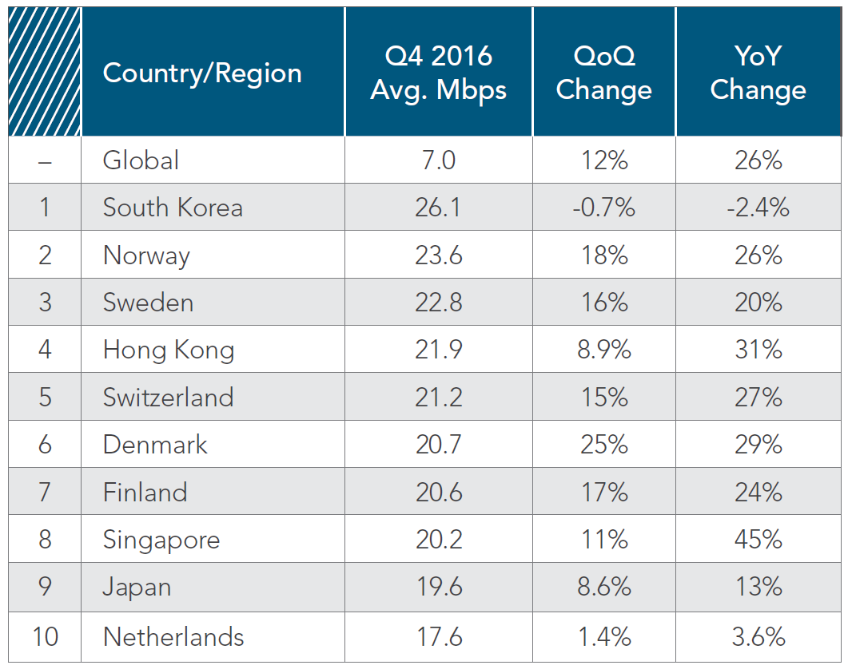
Streaming UHD reach
Just 8 countries have average broadband connection speeds 20+Mbps
Only South Korea exceeds 25Mbps
Q4 2016 Worldwide Average: 7Mbps (+26% YoY)
10% of connections exceeded 25Mbps in Q4 (+45%)
US picture rosier
DOCSIS 3.1 broadly rolling out
Washington D.C. third of connections above 25Mbps
10 states 20+% higher than 25Mbps (average +40% yoy)
  At this pace top ten states, 70% will be 25+Mbps by 2020
Broadband caps could be a problem
  Comcast, AT&T national 1TByte cap
  Good for 125 hours of UHD (24fps)
  Average TV viewership 125hrs per month
Notes:
Akamai Q4 2016 State of the Internet Report

Slide 55
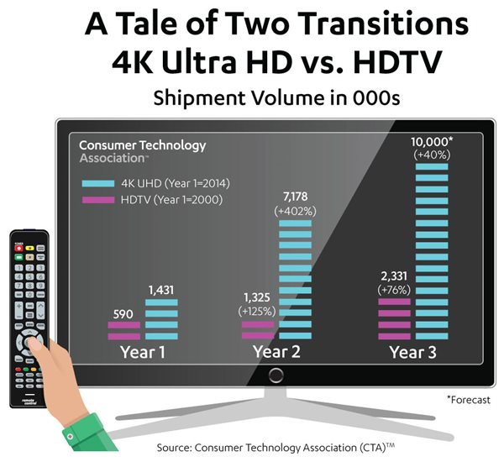
UHD TV sales going great
CTA says US UHD TV sales growing faster than HD at the same stage
UHD shipments in 2016 (year 3), 10M
  HD shipments in 2003 (year 3) , 2.3M
19M total sales
Worldwide UHD TV shipments
To grow from 55M in 2016, to 120M 2020
UHD HDR shipments to reach 30M in 2020
Notes:
https://www.cta.tech/News/Press-Releases/2016/November/2016-a-Banner-Year-for-4K-UHD-TV-Display-Sales-t.aspx

Slide 56
Will the UHD content be there to stream?
HD will dominate SVOD libraries by the end of this year
58% think by Sept 2017 75-100% of their library will HD
Online video service providers are an optimistic bunch
20% think at least 25% of their catalog by September

Slide 57
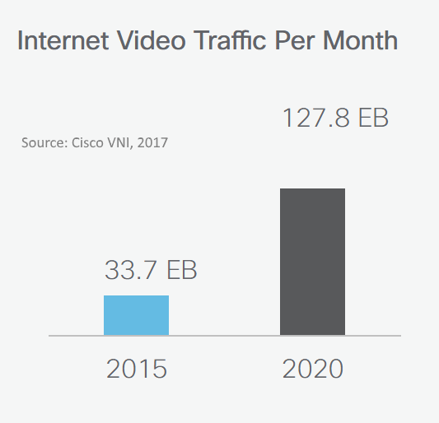
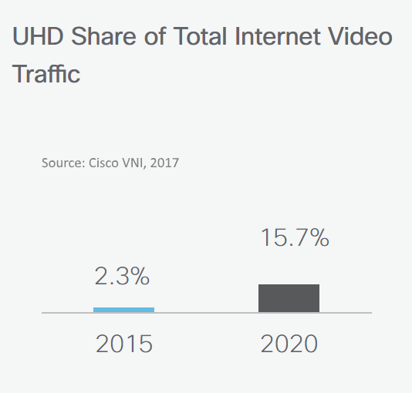
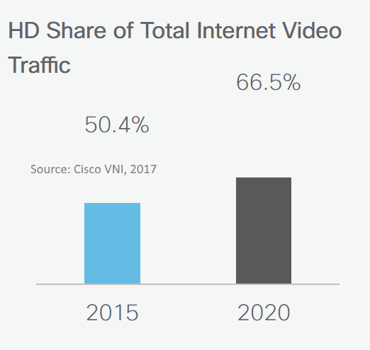
UHD use in 2020
Worldwide Internet Video traffic by 2020
128 Exabytes per month (79% of Internet traffic)
Up from 34 Exabytes per month in 2015
HD share of Internet video traffic in 2020
66.5%, up from 50% in 2015
85 Exahours of video
UHD share of Internet video traffic in 2020
15.7%, up from 2.3% in 2015
2.5 Exahours of video
Exa is 10¹⁸ , 1,000,000,000,000,000,000

Slide 58
Thank You
Colin Dixon, Founder & Chief Analyst, nScreenMedia
colin@nscreenmedia.com | twitter: @nscreenmedia

Slide 59
UHD HDR Session Agenda
Introduction and forum progress | Thierry Fautier, Forum President
HDR 101 | Matthew Goldman (Ericsson)
Interoperability lessons learnt so far | Renard T. Jenkins (PBS)
HDR in live services – operator panel | Akira Shimazu (SkyPerfect TV), Renard T. Jenkins (PBS), Stephan Heimbecher (SKY).
Premium HDR: What are we doing to ensure a quality experience? | Mike Zink UHD Alliance (Warner Bros.)
The analyst’s view on UHD will be bringing in 2018 and beyond. | Colin Dixon (nScreen Media)
Q&A

Slide 60
Thank You
www.ultrahdforum.org
Thierry Fautier | Harmonic | Thierry.Fautier@harmonicinc.com
Matthew Goldman | Ericsson | matthew.goldman@ericsson.com
Renard T. Jenkins | PBS | rtjenkins@pbs.org
Akira Shimazu | SkyPerfect TV | shimazu-akira@sptvjsat.com
Stephan Heimbecher | Sky DE | Stephan.Heimbecher@sky.de
Colin Dixon | nScnreen Media | colin@nscreenmedia.com
Ben Schwarz | CTOiC | bs@ctoic.net

